Slide 1

Introduction

Slide 2
Agenda
Infrastructure as Code (IaC)
Terraform examples
DEMO
Best Practices (suggestions)

Slide 3
Infrastructure as Code
Manage environment and resources via config files and scripts
Repeatable, immutable architecture
Collaboration
Agility

Slide 4
Terraform
Multi-cloud
Local/Remote State management
Support for HCL, Java, Python, Typescript, Go, etc via CDK
Modules
Notes:
HCL = Hashicorp Configuration Language
CDK = Cloud Development Kit Remote state avail with S3, Postgres, others

Slide 5
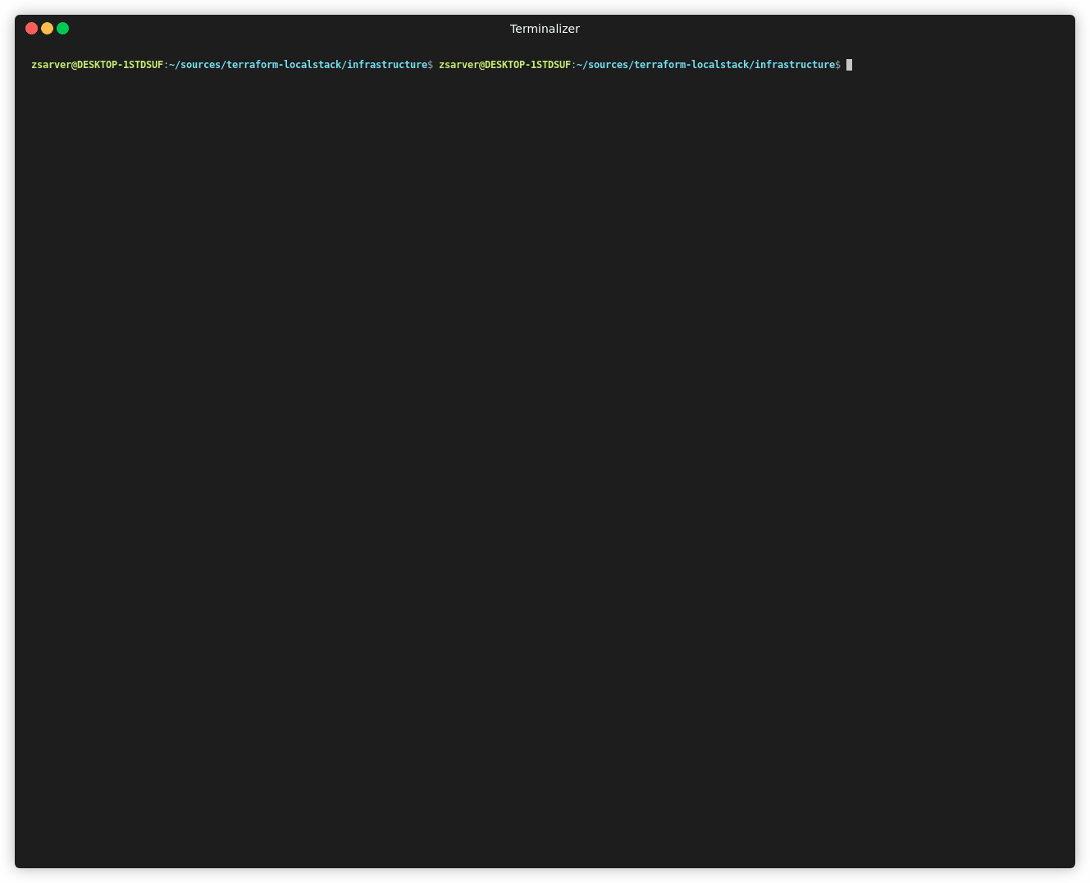
Demo / Code Walkthrough
Base environment standup
terraform plan
terraform apply

Slide 6
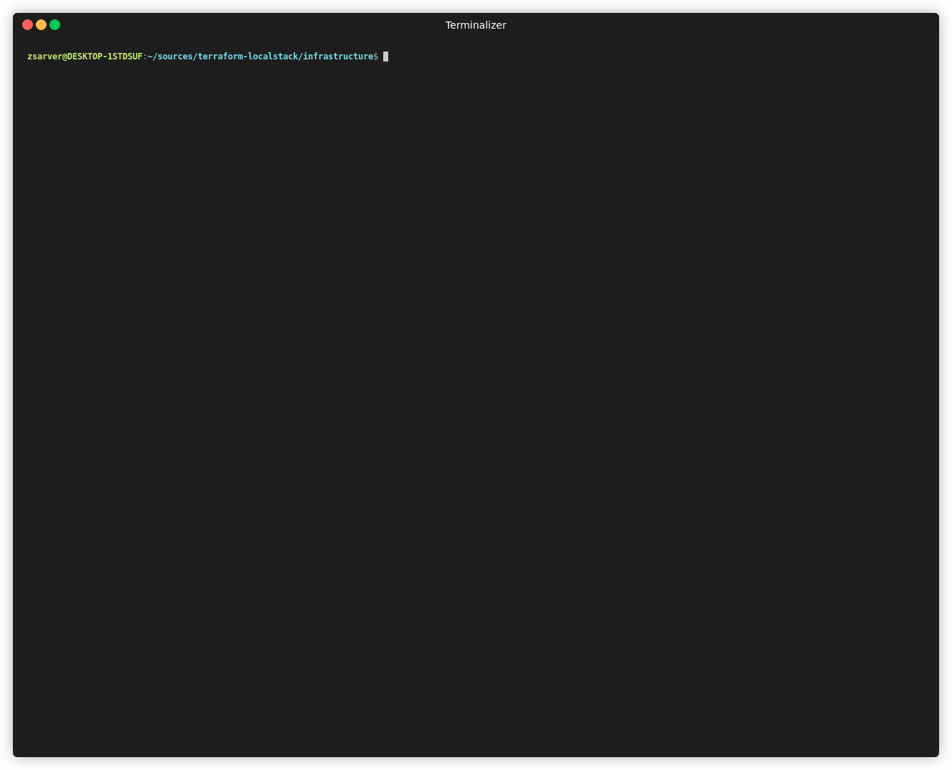
Demo / Code Walkthrough
Base environment standup
terraform plan
terraform apply

Slide 7
Demo / Code Walkthrough
Remove an environment
terraform destroy

Slide 8
Demo / Code Walkthrough
module "vpc" {
source = "terraform-aws-modules/vpc/aws"
name = "cds"
cidr = "10.0.0.0/16"
azs = ["us-east-1a", "us-east-1b", "us-east-1c"]
private_subnets = ["10.0.1.0/24", "10.0.2.0/24", "10.0.3.0/24"]
public_subnets = ["10.0.101.0/24", "10.0.102.0/24", "10.0.103.0/24"]
enable_nat_gateway = false
tags = {
Environment = "dev"
}
}
Modules
https://registry.terraform.io/
Providers for all major cloud hosts available
Pre-defined code for common infrastructure
Able to create custom modules

Slide 9
Demo / Code Walkthrough
Variables
variables.tf
Where variables are declared
*.tfvars
Values assigned to variables
To apply other tfvars
terraform apply –var-file=“dev.tfvars”
// variables.tf
variable "example-count" {
description = "Number of instances"
type = number
default = 1
}
// terraform.tfvars example-count=1

Slide 10
Demo / Code Walkthrough
Add EC2 Instance
resource "aws_instance" "example" {
count = var.example-count
ami = "ami-b374d5a5"
instance_type = "t2.micro"
tags = {
Environment = "dev"
}
}
Notes:
EC2 = Elastic Compute Cloud

Slide 11

Live Example

Slide 12
Best Practices / Suggestions
Terraform workspaces vs Folder per environment
Remote State
Use runatlantis.io for Pull Request review/approval of IaC changes
Utilize variables to control environment specific resource

Slide 13

Questions?

Slide 14
Appendix
Localstack
Localstack Standup
localstack start –d
Show service status
Localstack status services
Terraform Python & Typescript
Terraform Module Registry

